Slide 1
“Light and Life (2026-27)”
PowerPoint presentations
Copyright © 2026 by Robin Hill

Slide 3
Sunday 29th November 2026,
Advent 1

Slide 5
“The Good Professor”
a story of beginnings

Slide 7
… that life was the light of all mankind.

Slide 9


Slide 11
Sunday 6th December 2026,
Advent 2

Slide 13
“Nothing at All”
a story of kindliness

Slide 15
… clothe yourselves with compassion, kindness, humility, gentleness and patience.

Slide 17


Slide 19
Sunday 13th December 2026,
Advent 3

Slide 21
“Seeing Stars”
a story of solidarity

Slide 23
Go and do likewise.

Slide 25


Slide 27
Sunday 20th December 2026,
Advent 4

Slide 29
“Swing to Enter”
a story of paradise

Slide 31
… they must seek peace and pursue it.

Slide 33


Slide 35
Thursday 24th December 2026,
Christmas Eve All-Age Service

Slide 37
“The Kneeler”
a story of perspective

Slide 39
He guides the humble in what is right …

Slide 41
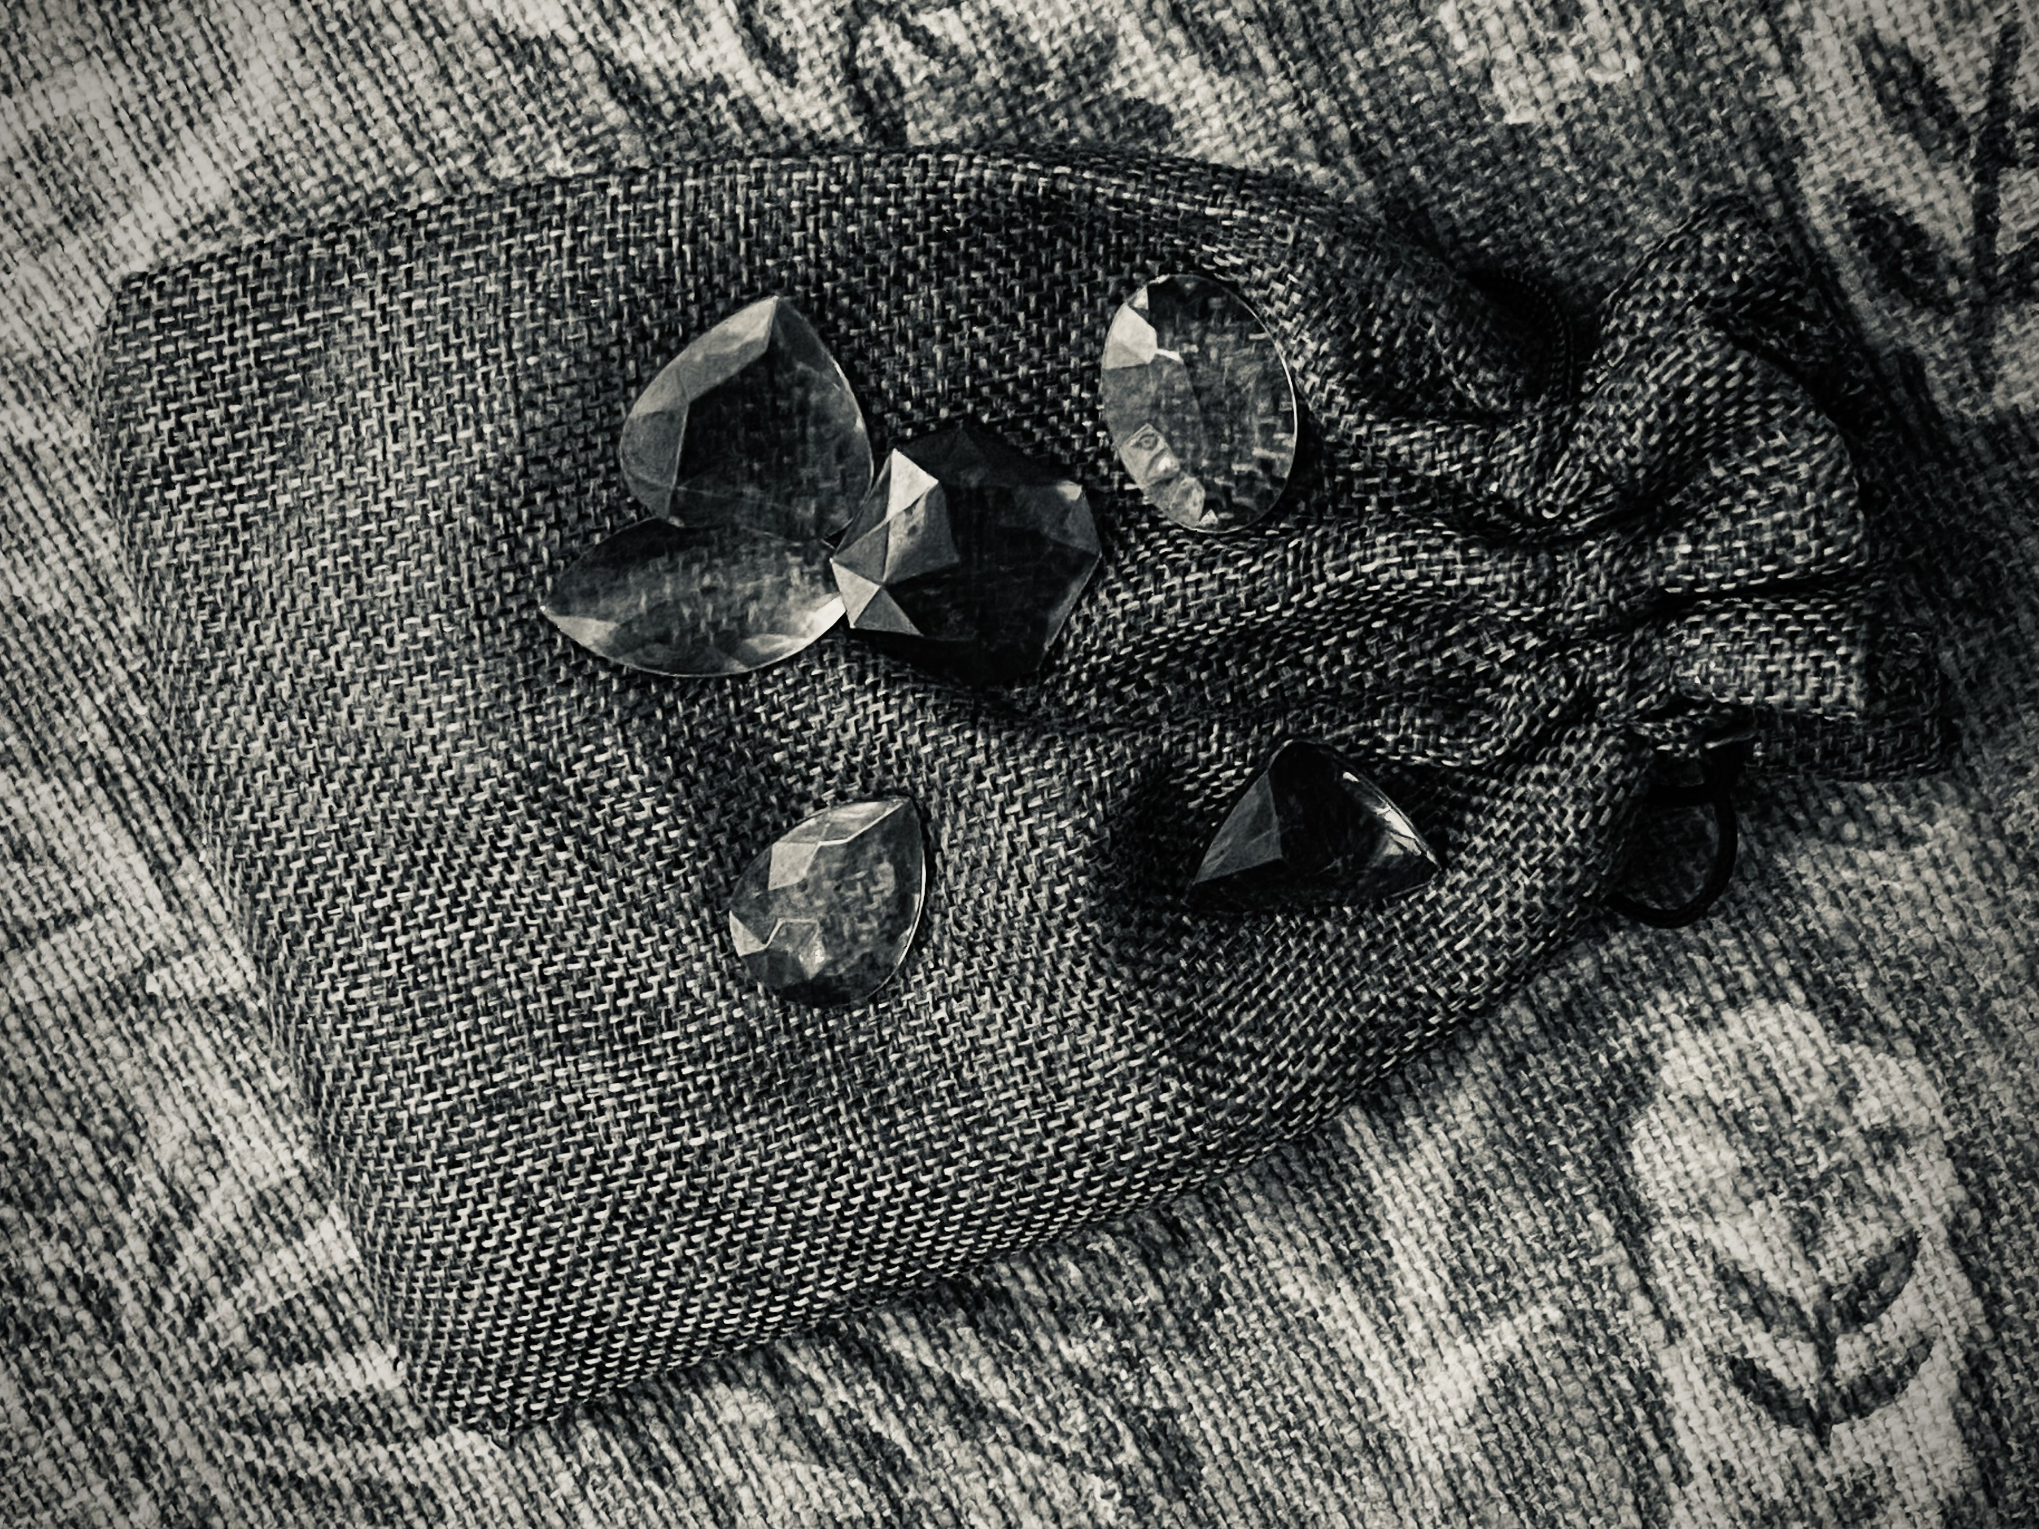

Slide 43
Thursday 24th December 2026,
Christmas Eve Watchnight Service

Slide 45
“Dapper Dan”
a story of impulse

Slide 47
… he kissed all his brothers and wept over them.

Slide 49


Slide 52
Friday 25th December 2026,
Christmas Day

Slide 54
“Spotted”
a story of concealment

Slide 56
… for the kingdom of God belongs to such as these.

Slide 58


Slide 60
Sunday 27th December 2026,
First Sunday after Christmas

Slide 62
“The Alderson Bequest”
a story of priorities

Slide 64
… serve him without fear.

Slide 66
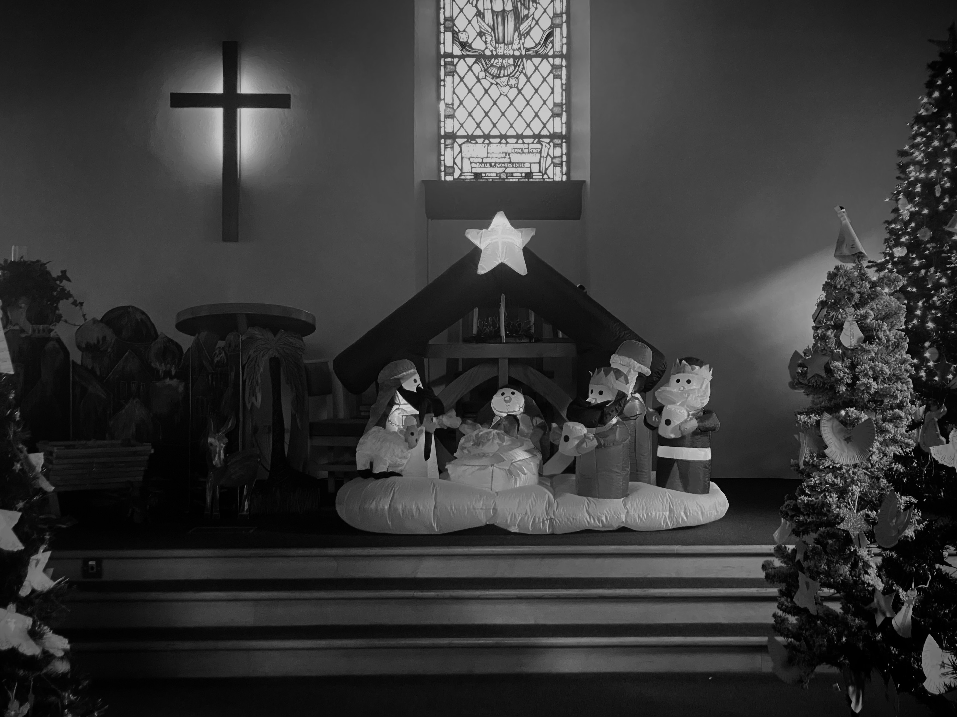

Slide 68
Sunday 3rd January 2027,
Sunday before Epiphany

Slide 70
“Fernanda’s Gifts”
a story of sensitivity

Slide 72
… and that he must be killed …

Slide 74


