Slide 1
“A Mission of Peace”
2025-26

Slide 3
Sunday 30th November 2025

Slide 5
“Maria and the Fire”
a story of wisdom

Slide 7
… the Lord watches over
the way of the righteous …

Slide 9
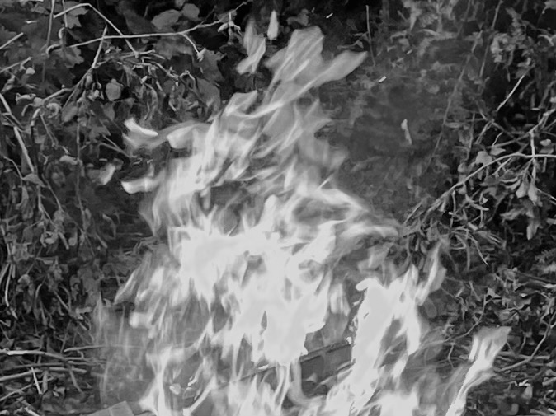

Slide 11
Sunday 7th December 2025

Slide 13
“Freckles”
a story of stamina

Slide 15
Then an angel of the Lord
appeared to him …

Slide 17
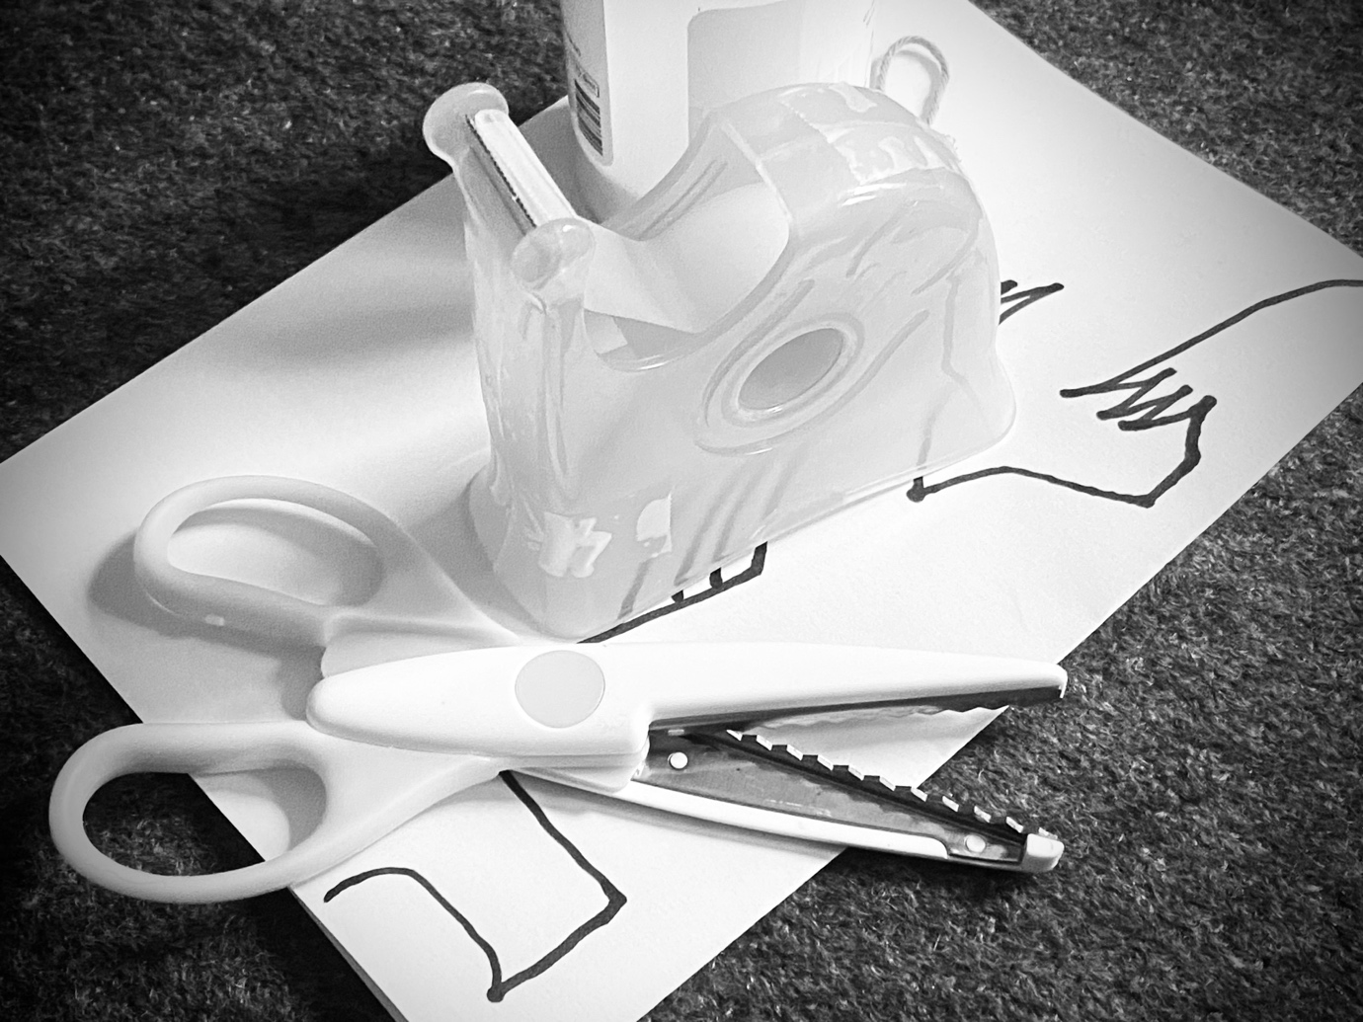

Slide 19
Sunday 14th December 2025, 9.45am

Slide 21
“The Missioner”
a story of stealth

Slide 23
… go into your room,
close the door
and pray to your Father …

Slide 25


Slide 27
Sunday 21st December 2025

Slide 29
“Solstice”
a story of loss

Slide 31
… we can comfort those in any trouble
with the comfort we ourselves
receive from God …

Slide 33
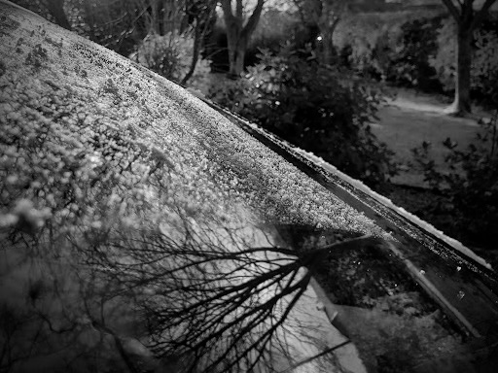

Slide 35
Wednesday 24th December 2025 (all-age)

Slide 37
“A1”
a story of justice

Slide 39
The midwives, however, feared God and
did not do what the king of Egypt
had told them to do …

Slide 41
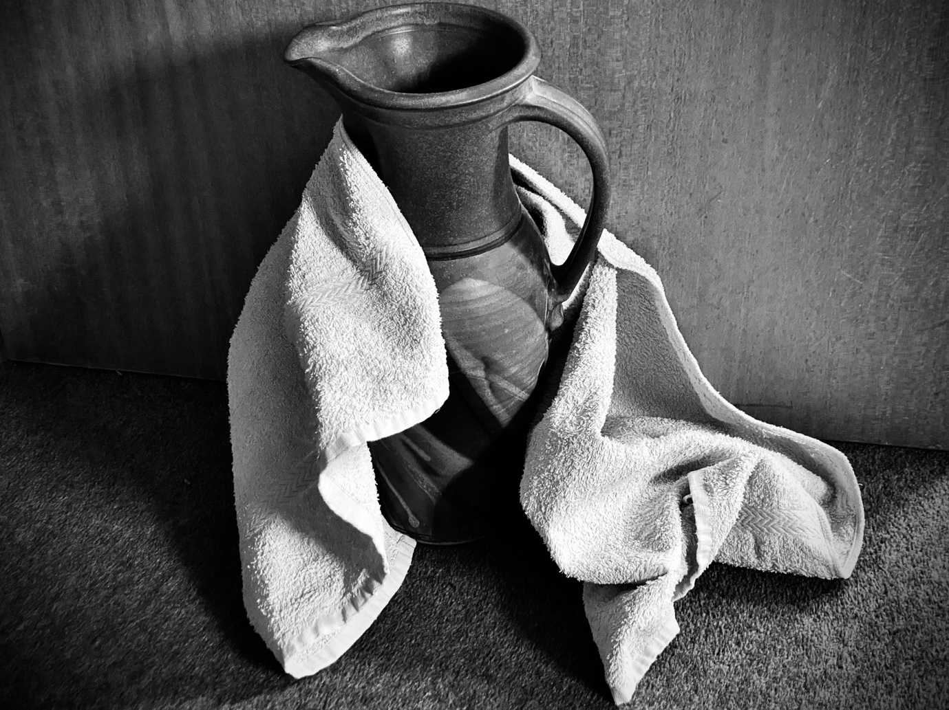

Slide 43
Wednesday 24th December 2025 (watchnight)

Slide 45
“Orion the Hunter”
a story of wonder

Slide 47
When I consider your heavens,
the work of your fingers,
the moon and the stars …

Slide 49
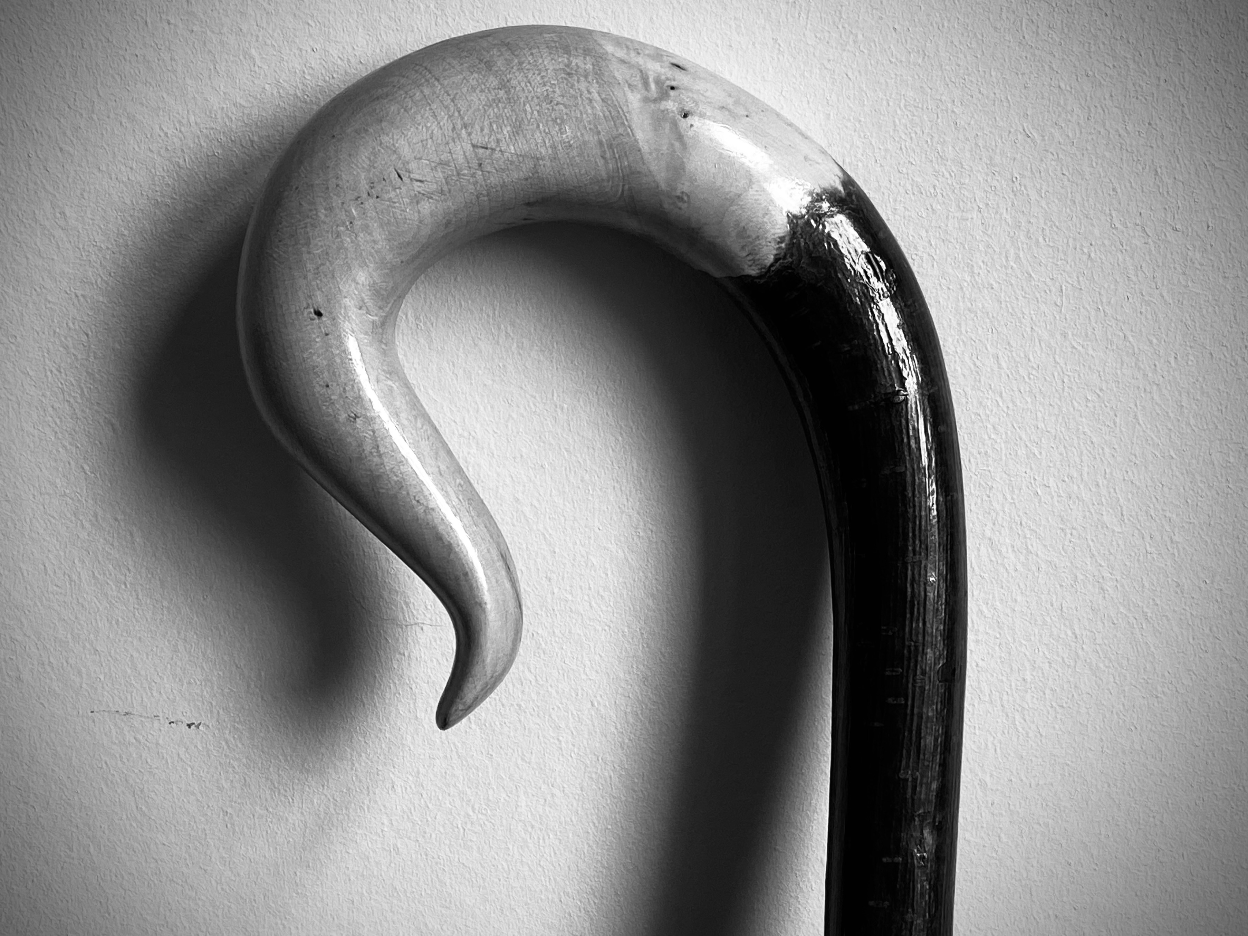

Slide 51
Thursday 25th December 2025

Slide 53
“Torkelsey Light”
a story of distance

Slide 55
They approach and come forward;
they help each other and say to their companions, ‘Be strong!’

Slide 57
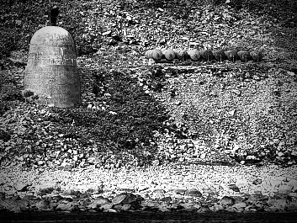

Slide 59
Sunday 28th December 2025

Slide 61
“Tear and Share”
a story of invitation

Slide 63
They worship me in vain;
their teachings are merely human rules.

Slide 65
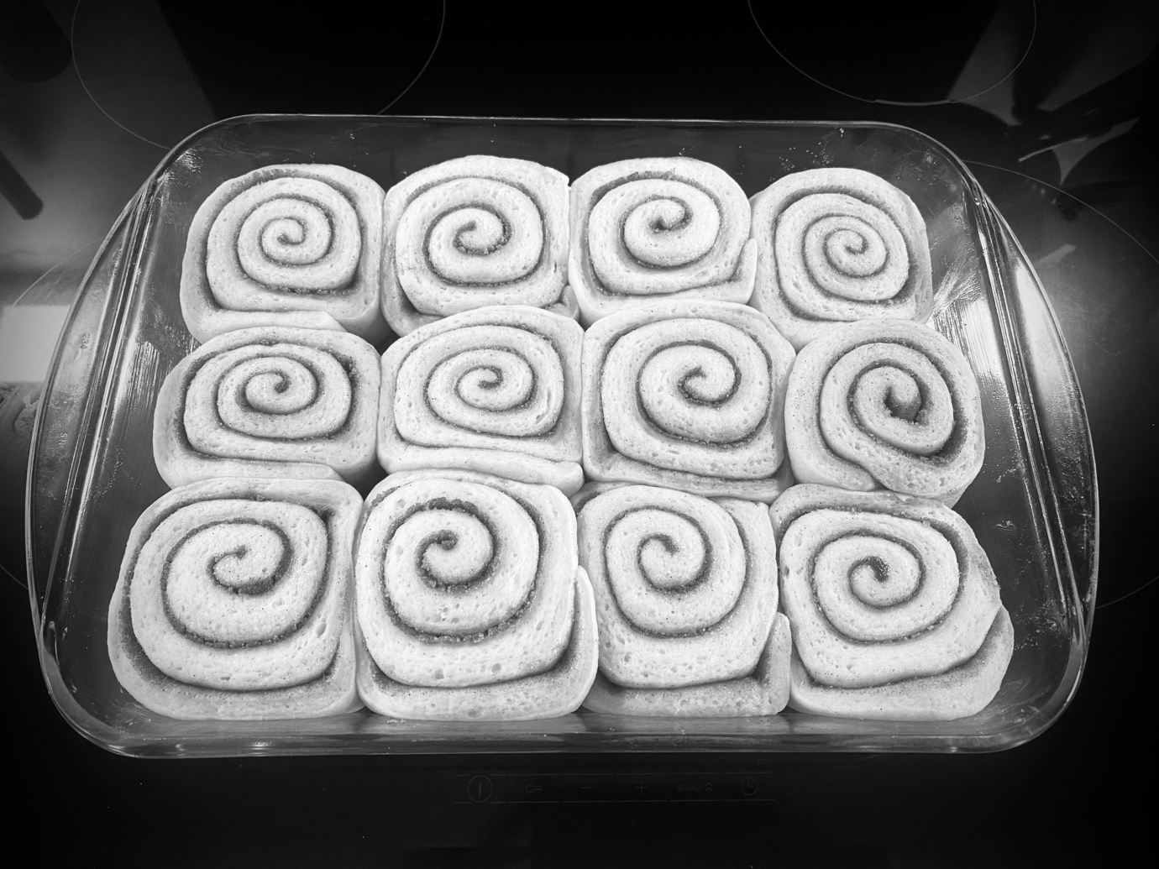

Slide 67
Sunday 4th January 2026, 11am

Slide 69
“Rough-hewn”
a story of striding

Slide 71
… Jesus resolutely set out
for Jerusalem

Slide 73


